Slide 1
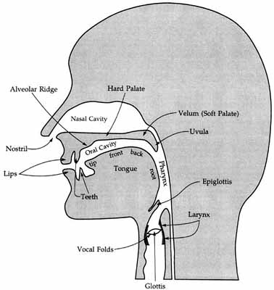
Week 2: Phonetics I
Rebecca Starr EL1101E
23/1/25 NUS AY2024-25

Slide 2
Reminders
Zoom office hours are happening each week on Fridays at 2 PM.
Tutorials will be starting on Week 4.
Assignment 1 will be released next week, but not due until Week 5.

Slide 3
Last week
We learned what linguistics is and where it originated.
We thought about what ‘knowledge of language’ entails.
Today, we are starting off our journey through linguistic structure with the smallest units of language, speech sounds!

Slide 4
Today
Introduction to speech
Approaches to studying phonetics
Articulatory Phonetics: how is speech produced?
Consonants
Introducing IPA

Slide 5

Let’s listen to some speech...
Things to think about:
Any guesses about what languages these are?
Can you tell where the boundaries between words are?
Can you tell where the boundaries between sentences are?

Slide 6
Listening to unfamiliar languages
Language A was Hmong, B was Scots Gaelic.
Even for languages we do not know, we can perceive some cues for sentence boundaries.
But we cannot identify the boundaries of words. Within a sentence, speech comes out in a pretty continuous stream.
Speech is often referred to as the speech stream.

Slide 7
Listening to unfamiliar languages
Common thoughts when hearing an unfamiliar language:
“Why are they speaking so quickly? How can anyone understand this??”
“How do people make these sounds? Why is this language so hard to pronounce??”

Slide 8
The language experts
Humans are, in many ways, experts in our native languages.
When we speak, we automatically coordinate our muscles to form the appropriate sound sequence.
When we hear a language we know, our brain automatically breaks it up and analyzes it.
These processes are invisible to us and seem easy.
But in fact, they are so complex that we have yet to train a computer to reliably do any of them.

Slide 9
The speech chain
What steps are involved in the speaking and listening process?
Although the speaker and hearer are two different individuals, we can conceive of the production and perception of speech as a single speech chain.

Slide 10
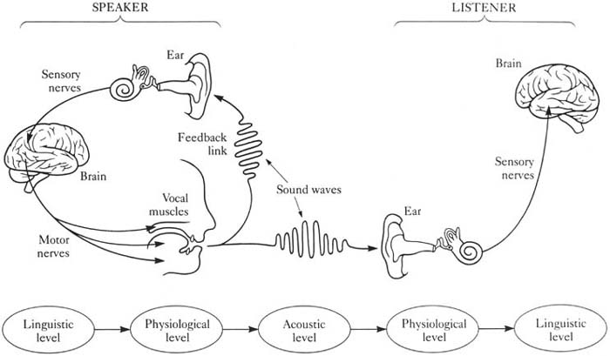
The speech chain
Linguistic
Level
Physiological
Level
Acoustic
Level
Physiological
Level
Linguistic
Level

Slide 11
Approaches to phonetics
Phonetics: the study of speech sounds.
As we saw in the chain, there are cognitive, physiological, and acoustic aspects of the production and perception of speech.
This means a lot to study, requiring many different types of research tools.

Slide 12
Approaches to phonetics
Three main areas of phonetics:
Articulatory phonetics: the study of how speech sounds are produced.
Acoustic phonetics: the study of the acoustic properties of the speech signal.
Auditory phonetics: the study of listeners’ perception of speech sounds.
Focus on articulatory phonetics in this module.

Slide 13
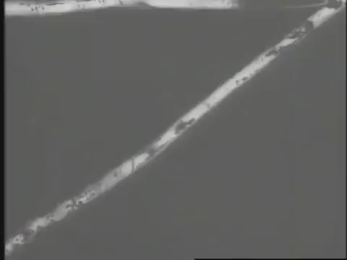
Articulatory Phonetics
How do we produce speech?
Let’s watch a slightly creepy X-ray video. Notice how many different parts are moving to produce these sounds:
https://www.youtube.com/watch?v=DcNMCB-Gsn8

Slide 14
Process of speech production
The voice is powered by air coming up from the lungs.
The human voice, including speech, is created by the way that air is molded by different parts of the vocal tract as it travels up to escape through our mouth and nose.

Slide 15
The Vocal Tract
(http://jcarreras.homestead.com/rrphonetics1.html)

Slide 16
The vocal tract
NASAL CAVITY
Upper Upper Alveolar Hard Velum Uvula
Lip Teeth Ridge Palate
ORAL CAVITY
Lower Lower Tongue:
Lip Teeth Tip Blade Front Back Root
Vocal Folds
Larynx
Glottis
Lungs

Slide 17
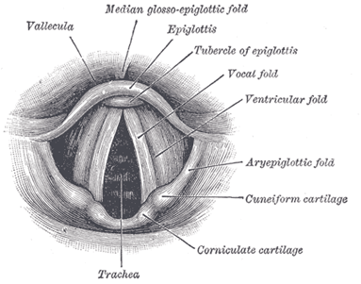
Larynx
Commonly called voice box / Adam’s apple.
Vocal folds can be manipulated into various configurations.
In certain configurations, air passing through causes the folds to vibrate, producing sound.

Slide 18
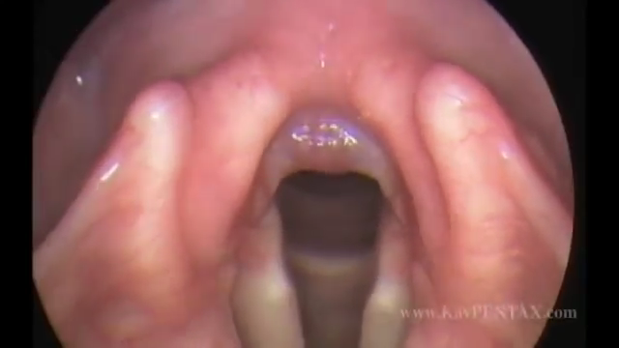
Clip of the vocal folds in action...
http://www.youtube.com/watch?v=mJedwz_r2Pc#t=18

Slide 19
Voicing
What is the difference between a “z” sound and an “s” sound?
Put your hand over your larynx and see if you can feel any difference between “zzzz” and “ssss.”

Slide 20
Voicing
The vocal folds provide one of the key distinctions in speech sounds:
Voiced: vocal folds vibrating
Voiceless: vocal folds not vibrating
Which of the following words start with a voiced consonant?
(a) pair
(b) shine
(c) judge
(d) bear

Slide 21
Voicing
Which of the following words start with a voiced consonant?
(a) pair: voiceless
(b) shine: voiceless
(c) judge: voiced
(d) bear: voiced

Slide 22
Voicing
What about vowels, are they voiced or voiceless?

Slide 23
Voicing
What about vowels, are they voiced or voiceless?
In English (and most languages), all vowels are voiced.

Slide 24
Nasal and Oral
Hold your nose and say “ahhhh”
Now hold your nose and say “mmmm”

Slide 25
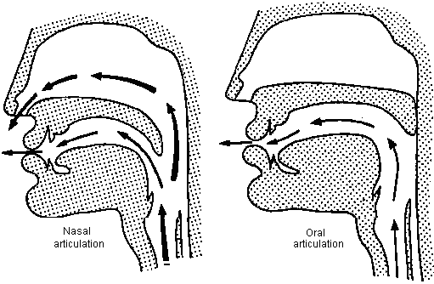
Nasal and Oral
Nasal:
velum lowered
Oral:
velum raised

Slide 26
Consonants vs. Vowels
Consonants: airflow through the oral cavity is obstructed in some way.
Vowels: airflow through the oral cavity is not obstructed.
Today, we’ll focus on (English) consonants.

Slide 27
Three key features capture consonants
1) Voicing (voiced vs. voiceless)
2) Place of articulation
Where is the air flow obstructed?
3) Manner of articulation
How is the air flow obstructed?
Includes nasality (oral vs. nasal)

Slide 28
Place of articulation: articulators
Obstructions are created using articulators (almost all in the oral cavity)
We can usually identify an active articular and a passive articulator.
For example, the tongue often moves up to contact part of the roof of the mouth.

Slide 29
Place of articulation: time for some Latin
Location Place of articulation
lips labial
teeth dental
alveolar ridge alveolar
hard palate palatal
soft palate (velum) velar
glottis glottal

Slide 30
Bilabial
Oral:
PET
BET
WET
Nasal:
MET
Which of these sounds are voiced vs. voiceless?

Slide 31
Labiodental
FINE (voiceless)
VINE (voiced)
Why are they called labiodental?

Slide 32
Interdental
THIN (voiceless)
THIS (voiced)
Wait, there are two “th” sounds? How are we supposed to write each one?

Slide 33
Interdental
Let’s learn our first two International Phonetic Alphabet (IPA) symbols:
THIN: [θ] (a Greek theta)
THIS: [ð] (called “eth”)
More about the IPA in a bit!

Slide 34
Interdental
Different people have different ways of making these sounds!
Some put their tongue between their teeth (interdental)
Others put their tongue behind their teeth (dental)
For this course, we’ll just call them “interdental”.

Slide 35
Alveolar
Oral:
TUNE
DUNE
SOON
ZOO
LOON
RUNE (note: the reading for this week classifies this sound as ‘retroflex’ instead of alveolar, but for this course we will consider it alveolar.)
Nasal
NOON

Slide 36
Post-alveolar
SHIP: [ ʃ ]
GENRE / MEASURE: [ ʒ ]
CHIP: [ tʃ ]
GYM: [ dʒ ]

Slide 37
Palatal
YES: [ j ]

Slide 38
Velar
Oral:
KIT
GIFT
Nasal:
KING, THINK [ ŋ ] (“engma”)
In English, engmas never appear at the beginning of a word or syllable. But they do in other languages like Cantonese.

Slide 39
Uvular?
We don’t have any uvular sounds in English.
But they are fun:
[ R ] Can you guess what sound this is?

Slide 40
Glottal
Produced by narrowing or closing vocal folds.
HAT
UH-OH: [ʔ] (“glottal stop”)
(NOTE: We often produce words that begin with vowels with an initial glottal stop (e.g., “apple”). However, this initial glottal stop is not considered part of the ‘basic’ pronunciation of the word, because it only appears in certain contexts. So, the first consonant in “apple” would be [p], not [ʔ].)

Slide 41
Summary: places of articulation in English
Bilabial: [b] [p] [m] [w]
Labiodental: [f] [v]
Interdental: [θ] [ð]
Alveolar: [d] [t] [n] [l] [s] [z] [r]
Post-alveolar: [ʃ] [ʒ] [tʃ] [dʒ]
Palatal: [j]
Velar: [g] [k] [ŋ]
Glottal: [h] [ʔ]

Slide 42
Manner of articulation
Is place of articulation enough information for us to distinguish between sounds?
[d] [z]
Both of those sounds are voiced alveolar consonants.
But they are obviously very different!

Slide 43
Stops
In a stop, the oral cavity is completely blocked.
There are two types of stop:
Oral stop (aka plosive):
[p], [b], [t], [d], [k], [g], [ʔ]
Good test for plosive: can you hold out the sound?
Nasal stop:
[m], [n], [ŋ]

Slide 44
Fricatives and Affricates
Fricative: partial obstruction, causing turbulence (a “buzzy” noise).
[f], [v], [θ], [ð], [s], [z], [ʃ], [ʒ], [h]
Affricate: a stop plus a fricative.
[tʃ], [dʒ]

Slide 45
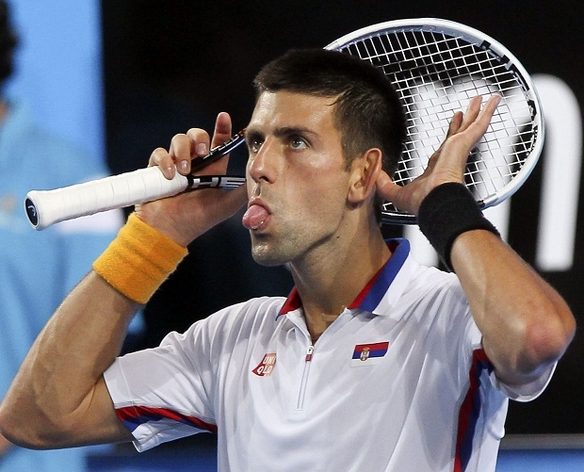
Fricatives and Affricates
Quiz yourself: which of these start with fricatives, and which with affricates?
(1) staple
(2) juice
(3) phase
(4) Cheryl
(5) Tsinghua University
(6) Djokovic

Slide 46
Fricatives and Affricates
Quiz yourself: which of these start with fricatives, and which with affricates?
(1) staple: [s] fric.
(2) juice: [dʒ] affric.
(3) phase: [f] fric.
(4) Cheryl: [ʃ] fric.
(5) Tsinghua: [tɕʰ] affric.
(6) Djokovic: [d͡ʑ] affric.

Slide 47
Approximants: Liquids and Glides
Liquids:
Constriction but no turbulence
[l] : lateral liquid
[r]: central liquid
Glides:
Also called “semi-vowels.” Very vowely.
[j], [w]

Slide 48
Summary of manners of articulation
Stops:
Plosives: [p], [b], [t], [d], [k], [g], [ʔ]
Nasals: [m], [n], [ŋ]
Fricatives: [f], [v], [θ], [ð], [s], [z], [ʃ], [ʒ], [h]
Affricates: [tʃ], [dʒ]
Approximants:
Liquids: [l], [r]
Glides: [j], [w]

Slide 49
How can we distinguish these consonants?
How many distinguishing features do we need to identify any consonant?
How about:
Voiced bilabial

Slide 50
How can we distinguish these consonants?
How many distinguishing features do we need to identify any consonant?
How about:
Voiced bilabial: could be [m], [b], or [w]

Slide 51
Distinctive features
Maximum info we need to identify any consonant:
Voicing
Place
Manner
Reminder: includes nasality
For liquids, we need lateral / central.
Certain consonants of English are identifiable with less info (e.g., [j]).

Slide 52
Practice: identify the consonants!
(a) voiceless alveolar oral fricative
(b) voiced velar nasal stop
(c) voiceless bilabial oral stop

Slide 53
Practice: identify the consonants!
(a) voiceless alveolar oral fricative: [s]
(b) voiced velar nasal stop: [ŋ]
(c) voiceless bilabial oral stop: [p]

Slide 54
Why do we need the International Phonetic Alphabet?
As we have seen, using Roman letters makes it difficult for us to identify each English consonant.
In general, the alphabet is not great for phonetics. For one thing, different languages use it differently:
English French German
chair chaise Bach

Slide 55
Why do we need the International Phonetic Alphabet?
English in particular has very inconsistent spelling:
tough [ʌf]
though [oʊ]
through [u]
thought [ɔ:]
bough [aʊ]

Slide 56
What is the IPA?
A special set of alphabetic characters representing speech sounds, designed to phonetically transcribe language.
Designed to represent all speech sounds in every language consistently.
Consists of letters and diacritics (little symbols that indicate minor variations).

Slide 57
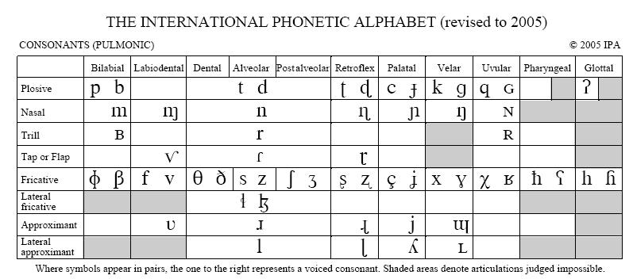
Consonant section of full IPA chart
Full IPA chart here: https://www.internationalphoneticassociation.org/sites/default/files/IPA_Kiel_2015.pdf

Slide 58
English consonants (all the consonants you need for this module)
 | BILABIAL | LABIODENTAL | INTER-DENTAL | ALVEOLAR | POST-ALV. | PALATAL | VELAR | GLOTTAL
PLOSIVE | p b |  |  | t d |  |  | k g | ʔ
NASAL | m |  |  | n |  |  | ŋ
FRICATIVE |  | f v | θ ð | s z | ʃ ʒ |  |  | h
AFFRICATE |  |  |  |  | tʃ dʒ
LIQUID (CENTRAL) |  |  |  | r
(LATERAL) |  |  |  | l
GLIDE | w |  |  |  |  | j

Slide 59
How do we transcribe using IPA?
We write IPA within square brackets to indicate a phonetic transcription.
Depending how precise we want to be, we can use a more narrow (detailed) or broad transcription.
narrow broad
“pan”: [p^{h}æ̃n] [pæn]
For this module, we will focus on broad transcription.
To type in IPA, I recommend this tool: http://westonruter.github.io/ipa-chart/keyboard/

Slide 60
Is the IPA always the same for English?
The IPA represents pronunciation. If a word is pronounced differently, it is transcribed differently.
Ex: “water” is pronounced very differently in the US vs. UK:
Thus, there is no single correct IPA for English.
This variation comes up more for vowels, so we will return to this question next week.
[wɑɾər] [wɔtə]

Slide 61
Are we learning the “real” IPA?
In this module we are using a few common simplifications often used in the transcription of English.
Most notably, in official IPA, [r] represents an alveolar trill (as in Malay and Spanish), while [ɹ] represents the English r sound.
No one wants to get stuck writing an upside-down r for no reason.

Slide 62
Are you lying to us about anything else??
If you look on the full IPA chart, you may be distressed to discover that [w] is missing from the main consonant chart.
That’s because, technically, [w] has a “labio-velar” place of articulation. You can find [w] in the “other symbols” section of the official IPA chart.
For the purposes of this class, treat [w] as bilabial.

Slide 63
Can I find IPA transcriptions of words in the dictionary?
While some dictionaries use the IPA to indicate pronunciation, others use their own systems.
One useful resource for IPA is Wiktionary.
If you google almost any word followed by wiktionary, you’ll find a Wiktionary entry that lists the US and UK transcriptions of that word in IPA.
Another source: the Cambridge Dictionary.

Slide 64
Why am I finding some consonants difficult to distinguish?
Although Singapore English doesn’t differ much from US or UK English for consonants, there are a couple things you should be aware of.

Slide 65
Why am I finding some consonants difficult to distinguish?
Final consonant devoicing: in Singapore, many speakers pronounce voiced consonants at the ends of words as voiceless.
Do ‘peace’ and ‘peas’ sound the same to you?
th/dh stopping: in Singapore, many speakers pronounce [θ] as [t] and [ð] as [d].
Do ‘thin’ and ‘tin’ sound the same to you?

Slide 66
Why am I finding some consonants difficult to distinguish?
Don’t worry – we won’t be testing you on distinguishing sounds that we know are difficult for speakers of Singapore English.
But it is interesting to learn about the distinctive features of Singapore English!
We will return to this topic next week when we learn about vowels.

Slide 67
IPA Consonant Practice
Try to guess these words:
(1) [dʒulaɪ]
(2) [θɪŋk]
(3) [ðɛn]
(4) [mɛʒər]
(5) [mɛnʃən]

Slide 68
IPA Consonant Practice
Try to guess these words:
(1) [dʒulaɪ] July
(2) [θɪŋk] think
(3) [ðɛn] then
(4) [mɛʒər] measure
(5) [mɛnʃən] mention

Slide 69
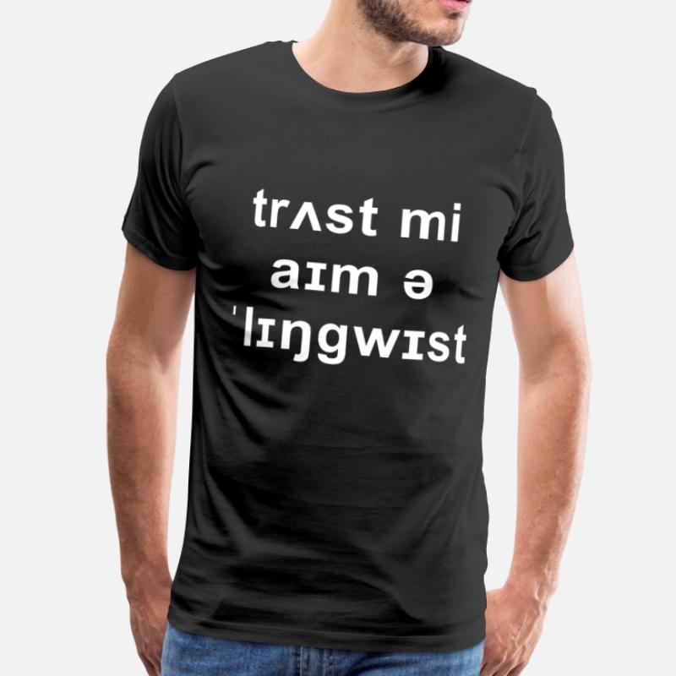
Next week
Vowels and stress

